Slide 1

Wildlife Protection of Endangered Species
DSC 680 Applied Data Science
Chitramoy Mukherjee, T301 T302 2253 Winter 2025

Slide 2
Introduction
An endangered species is a type of organism that is threatened by extinction. Species become endangered for two main reasons: loss of habitat and loss of genetic variation. The conservation of endangered and rare wildlife is a primary part of preserving biodiversity. The purpose of this project is to intelligently monitor endangered and rare wildlife species by using Machine Learning models with animal data and computational resources from various parks in United States.
Problem Statement
Endangered and rare wildlife species face significant threats due to habitat loss,
climate change, poaching, and human activities. The urgent need to monitor and
protect these species has led to the development of a Wildlife Protection AI/ML
project. This project aims to leverage advanced machine learning models and
computational resources to analyze comprehensive datasets from various
parks in the United States. By predicting conservation status, identifying critical threats,
and assessing habitat suitability, the project seeks to enhance conservation efforts, prioritize resource allocation and ensure the survival of endangered species for future
generations.

Slide 3
Background and Data Sources
The Wildlife Protection of Endangered Species project aims to address the critical threats faced by endangered and rare wildlife species. With increasing habitat loss,
climate change, poaching, and human activities, there is an urgent need for
innovative solutions to monitor and protect these species. Leveraging advanced
machine learning models and computational resources, the project seeks to predict
conservation status, identify critical threats, and assess habitat suitability. The
ultimate goal is to enhance conservation efforts, prioritize resource allocation, and ensure the survival of endangered species for future generations.
final_species.csv from
https://www.kaggle.com/datasets/nationalparkservice/park-biodiversity/data?select=species.csv
Final_web_species_data.csv from
https://irma.nps.gov/NPSpecies
Final_api_species_data.csv from
Animals API - API Ninjas (api-ninjas.com)

Slide 4
Methods/Steps
Data Preparation
Geospatial Analysis
Species Identification and Monitoring
Threat Detection and Prediction
Data Visualization and Reporting
Define category and model determination
Model outcome comparison

Slide 5
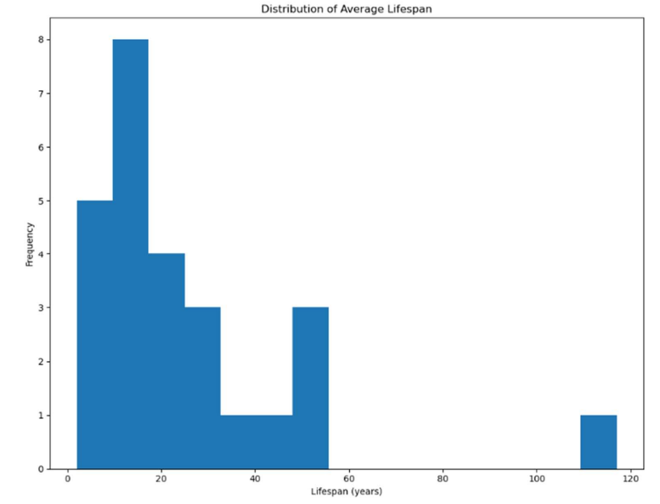
Distribution of Average Lifespan of species in years
Average lifespan is a numerical variable but contains some non-numeric values like "Unknown". We need to clean this data, convert it to numeric, and then we can use a histogram plot to visualize the distribution of lifespans. Majority of the species are falling under 20-30 years of average lifespan.

Slide 6
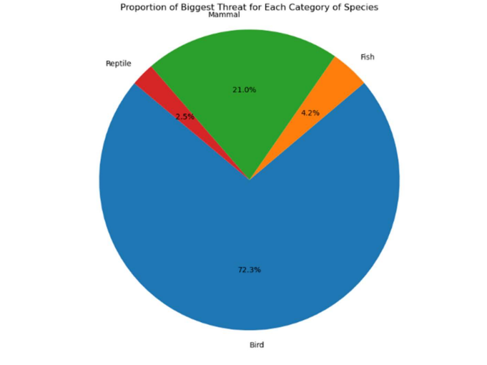
Proportion of Biggest Threat for each Category of Species
This visualization involves grouping the data by category and biggest_threat, counting the occurrences, and then plotting the family with the highest count of the biggest threat.
This visualization is created on merged dataframe with filtered 'Unknown' values for biggest threat (new_df). Here category 'Bird' are under biggest threat.

Slide 7
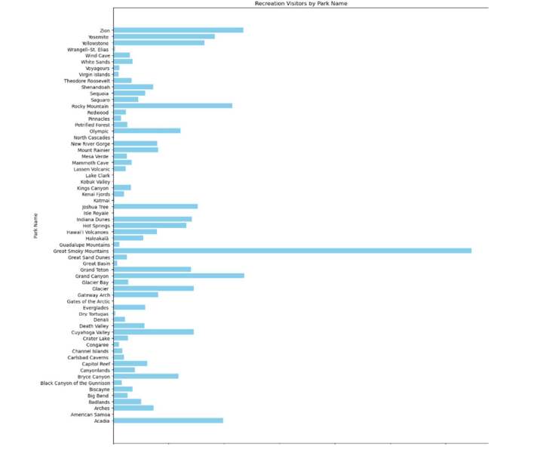
Recreation visitors by Park Name
This visualization is to show number of recreation visitors by Park Name. It is shown by bar graph and is generated from individual web_species_df which contains park details from website.
In below visualization, 'Great Smoky Mountains' national park got exceptionally high count of recreation visitors. In previous visualizations, 'Sequioa and Kings Canyon National Park' shows highest threat, but number of recreation visitor is comparatively low with repect to other parks. Based on that, number of Recreation visitors doesn't seem to be impacting the cause of biggest threat for Sequioa.

Slide 8
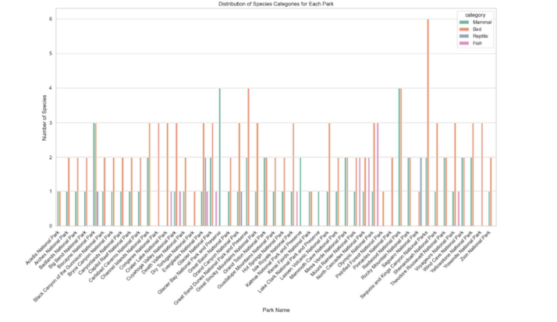
Species category distribution for each park
This visualization is to identify which different categories of species are habitat for each park. The count plot is developed using Seaborn library. Based on the plot, for Sequioa and Kings Canyon National Park species category 'Bird' and 'Mammal' are more prevalent as compared to other parks. This visualization is showing relationship between Sequioa and Kings Canyon National Park and threat as Sequioa and Kings Canyon National Park is showing biggest_threat count across all US parks, also it got identified that 'Bird' category species is at highest threat based on previous plots and since Sequioa and Kings Canyon National Park got the 'Bird' as the most popular and highest count species, this park might be at a risk of endangered bird species.

Slide 9
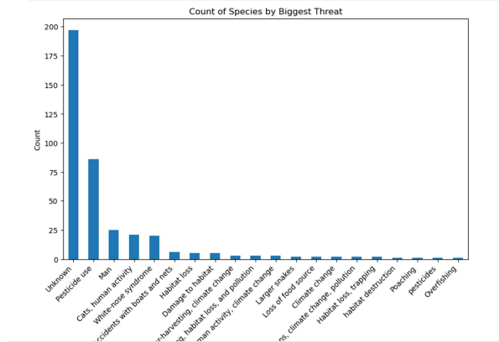
Count of species by biggest Threat
Attached visualization shows count of species by their biggest threat. Here 'biggest_threat' is a categorical data and a bar graph is appropiate for visualizing its frequency. Based on the bar graph, majority of the threat data is 'Unknown' which can be ignored for further analysis. The next biggest threats are 'Pesticide use', 'Man', 'Cats, human activity'

Slide 10
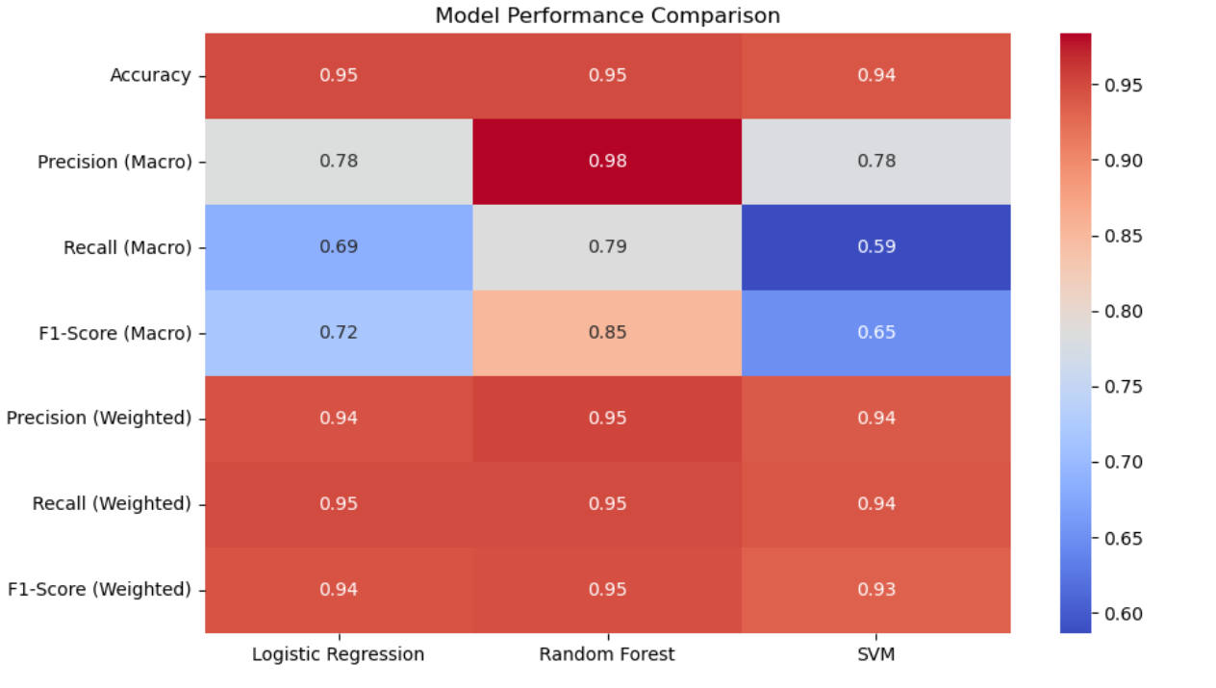
Model Output Comparison Conclusion 'Bird' category species is at highest threat based on previous plots and since Sequioa and Kings Canyon National Park is showing the highest count of species under Biggest Threat and got the 'Bird' as the most popular and highest count species, this park might be at a risk of endangered bird species.

Slide 11

Thanks!!!

